Slide 1
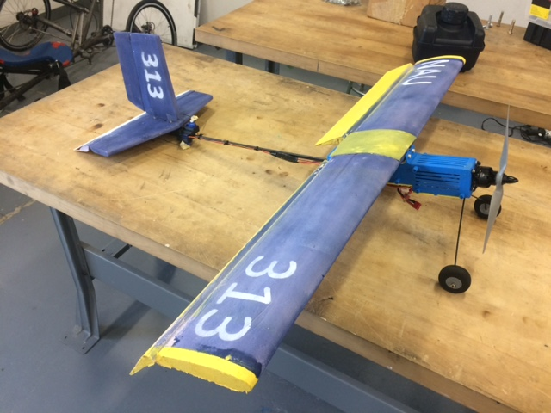
Team Aeolus #313
Yaqoub Almounes
John Cowan
Josh Gomez
Michael Medulla
Mohammad Qasem

Slide 2
Micro Class Requirements
Rules & Objectives
10 lb weight limit
Container with 6” cross section
Payload bay, 1.5” X 1.5” X 5” dimensions
Electronic Propulsion
11.1 V maximum motor power
2200 mAh maximum battery capacity
Mohammad Qasem | Team 18 | Northern Arizona University

Slide 3
Micro Class Requirements
Design Report
30 page design report detailing aircraft capabilities and features.
Oral Presentation
10 minute presentation explaining the manufacturing process, testing, and projected results
Flight
7 rounds of flight testing. Only scored if the aircraft successfully flew through the entire round
John Cowan| Team 18 | Northern Arizona University

Slide 4
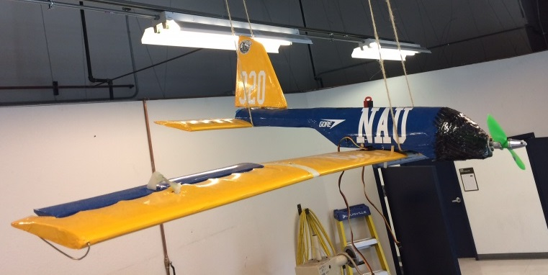
Previous NAU Design
IMPROVEMENTS:
1) Increase Chord Length (Wing and Horizontal Stabilizer)
2) Wings above fuselage
3) Decrease body size
4) Landing Gear
Mohammad Qasem | Team 18 | Northern Arizona University

Slide 5
Trade Studies
Wing
Horizontal Stabilizer
Cockpit
Propeller
10” length, 5° pitch
11” length, 5° pitch
12” length, 6° pitch
Delta Wing
Square Wing
Tapered
Rectangular
Square
Circular
Flying Wing
Criteria:
Lift
Weight
Manufacturability
6” cross-section
Criteria:
Lift
Aerodynamics
Manufacturability
Weight
Criteria:
Drag
Weight
Manufacturability
Payload Bay
Criteria:
Thrust
Quantity
Weight
John Cowan| Team 18 | Northern Arizona University

Slide 6
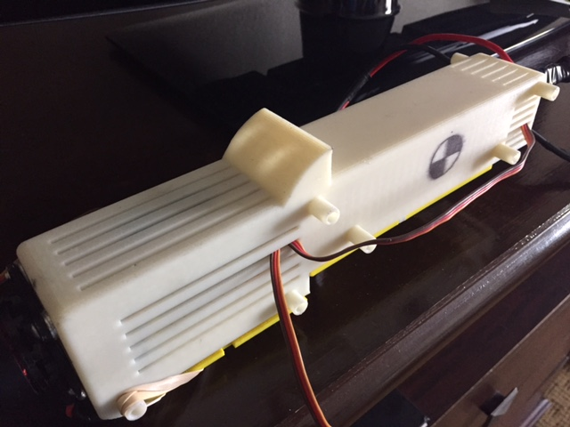
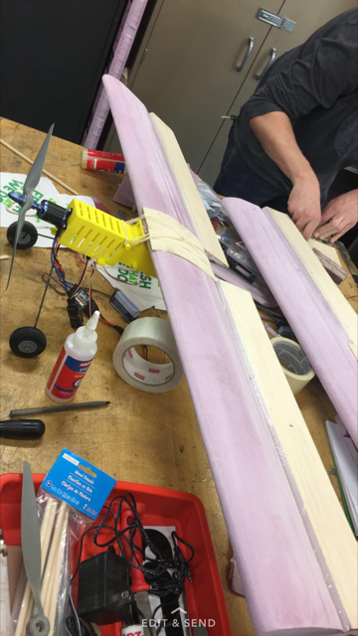
Unique Approach
In the competition, our design had a couple features that no other plane utilized
Foam Material (Wings & Rudder)
3D Printing
3D Printed Body
Foam Wings
Josh Gomez| Team 18 | Northern Arizona University

Slide 7
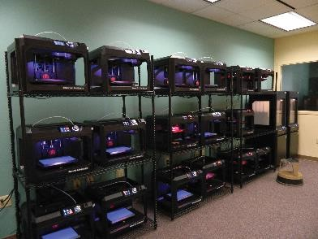
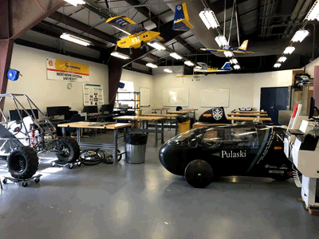
Manufacturing
NAU Library 3D Printing
NAU Machine Shop
Yaqoub Almounes| Team 18 | Northern Arizona University

Slide 8
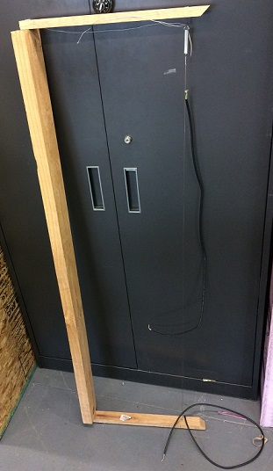
Manufacturing (Wings)
GOE 430 airfoil
42” wingspan, 8” chord length gives AR of 5.25
Hot wire cutter used to create wings
Duplicate wings in case of failure
Ailerons made out of foam + balsa wood
$$AR=\frac{b}{c}$$
b = wingspan
c = chord length
Hot Wire Foam Cutter
GOE 430 Airfoil [2]
Josh Gomez| Team 18 | Northern Arizona University

Slide 9
Manufacturing (Cockpit)
Cockpit includes payload bay & electronics cargo
3D printed, ABS plastic
CG aligned with center of payload bay
Cockpit, top view
Cockpit, bottom view
Yaqoub Almounes | Team 18 | Northern Arizona University

Slide 10
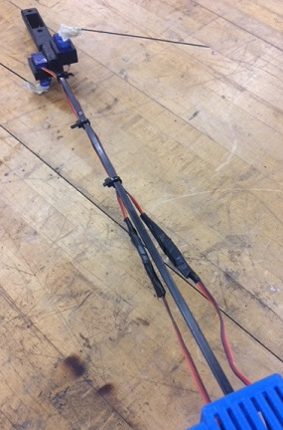
Manufacturing (Fuselage)
Two carbon fiber rods
One vertical, one horizontal to eliminate bending
Reduced rod length to align CG
Specific Design to fit in the tail and cockpit
Cross Section
Carbon Fiber Rod Fuselage
Michael Medulla| Team 18 | Northern Arizona University

Slide 11
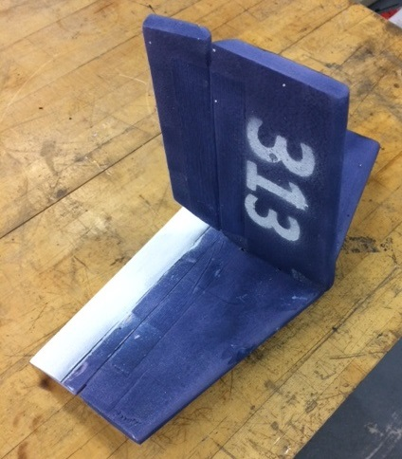
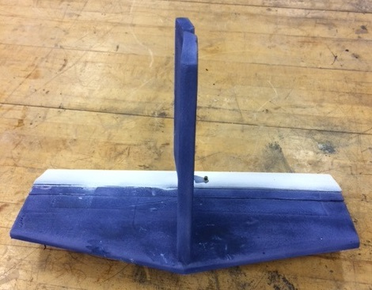
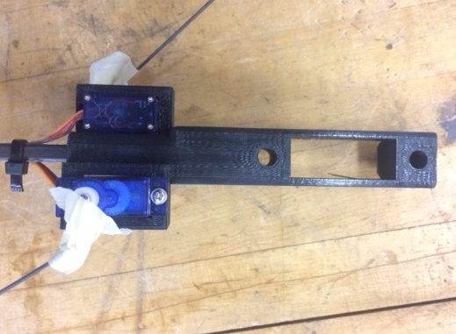
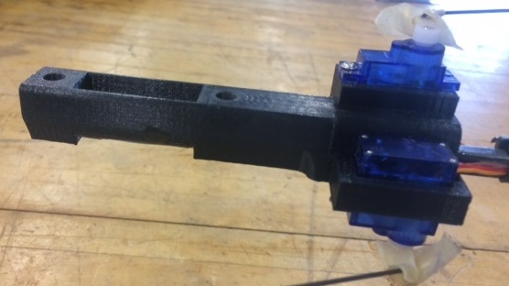
Manufacturing (Tail)
Tapered shape
Tail mount connects tail to fuselage
Tail mount 3D printed, ABS plastic
Elevator made of foam + balsa wood
Horizontal Stabilizer & Rudder
Tail mount, side view
Tail mount, top view
Michael Medulla| Team 18 | Northern Arizona University

Slide 12
Finished Design
Propeller, motor, servos, and landing gear from previous years designs and previous flight experience.
Total spent: $300
Final Design
Josh Gomez | Team 18 | Northern Arizona University

Slide 13
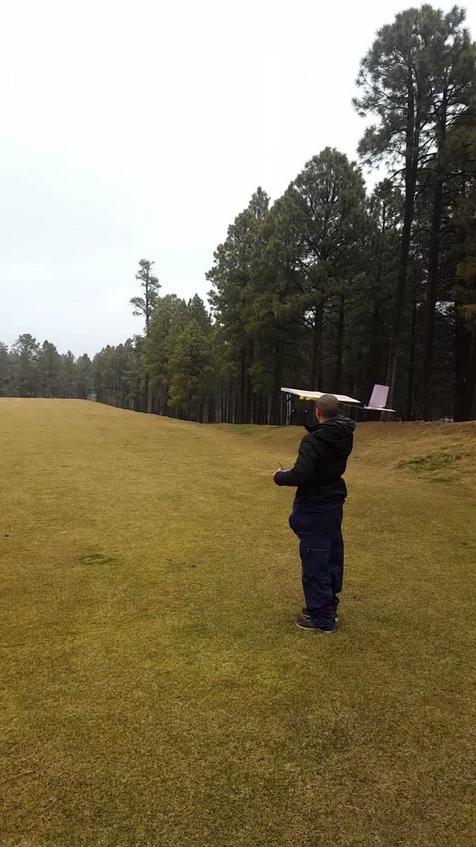
Testing
First flight was a success!
Weather conditions were awful. High wind speeds and snow during testing.
Large elevation difference from Flagstaff (7000 ft) to Fort Worth, TX (500 ft)
Broke rudder on first test flight
Yaqoub Almounes| Team 18 | Northern Arizona University

Slide 14
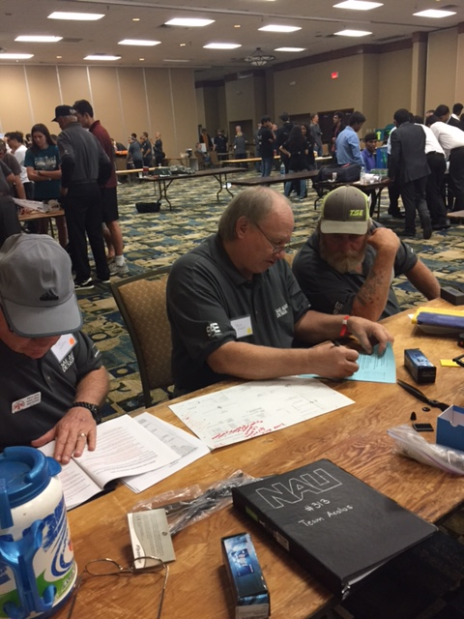
Results
During the first round, the pushrod came loose from the elevator, causing the aircraft to crash nose first.
The tail mount, wing, propeller, and engine mount broke from the crash.
Following the first round, the team was unsuccessful in completing a flight.
Inspection Table
John Cowan| Team 18 | Northern Arizona University

Slide 15
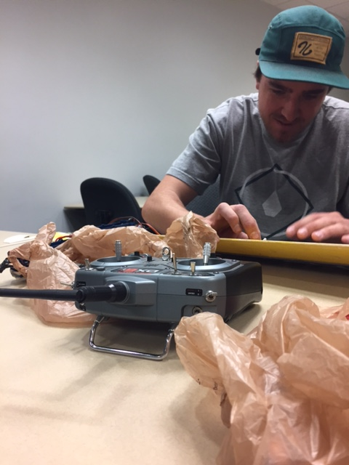
Improvements
Remove landing gear.
Circular carbon fiber rod substituting the fuselage beams.
Removed rear wheel from tail mount.
Added fin to bottom of tail mount to protect servos upon landing.
Michael Medulla| Team 18 | Northern Arizona University

Slide 16
Re-Testing
Michael Medulla| Team 18 | Northern Arizona University

Slide 17
References
[1] "2017 Collegiate Design Series SAE Aero Design Rules“, 2017. [Online]. Available: https://www.saeaerodesign.com/content/2017_AERO_RULES_FINAL.pdf
[2] "GOE 430 AIRFOIL (goe430-il)," in Airfoil Tools, 2017. [Online]. Available: http://airfoiltools.com/airfoil/details?airfoil=goe430-il

Slide 18
Thank you.

